Slide 1


HUM 102 Report Writing Skills
Lecture 18

Slide 2

Previous Lecture
Basics of Email
Steps of Effective Email Writing

Slide 3



Email Writing
Email Structure: Opening Sentence
Provides reasons for writing
Responds to ongoing communication
Develops a link between interlocutors

Slide 4
Email Writing
Opening Sentence: Examples
Following our phone conversation, I am sending you…
Attached, please find the documents you requested regarding…
In regards to the upcoming pilot program, I have listed below the tasks and deadlines that need to be completed.
Further to our last discussion, I would like to bring to your attention the following issues:
As we agreed, there will not be …
Please reconsider our proposal for …
In response to your job post for Marketing Director, please find below a brief overview of my skills. I have also attached my CV for your review.

Slide 5
Email Writing
Opening Sentence: Supporting Details
Here is the detailed list:
In addition to the attached agenda, please click on this link http://www...
To register for the online event, please go to...

Slide 6
Email Writing
Email Structure: Closing Sentence
Maintain the link
Call to action
Pave the way for the receiver to provide a feedback in reply of email
Appreciate with a thank you note

Slide 7
Email Writing
Closing Sentence: Examples
I look forward to your reply.
Thank you for the time you have taken to review my candidacy for the position.
Please don’t hesitate to contact me with any questions or concerns you may have.
Thank you, in advance, for your time.
I await receipt of the information we discussed.
Please forward me the exact information.

Slide 8
Email Writing
Sign Off
Sincerely,
Thank you,
Best Regards,
Best,
Thanks,

Slide 9
Email Writing
Addressor’s Information
Signature
Name
Title
Company name
Email
Phone/Fax
Web address

Slide 10
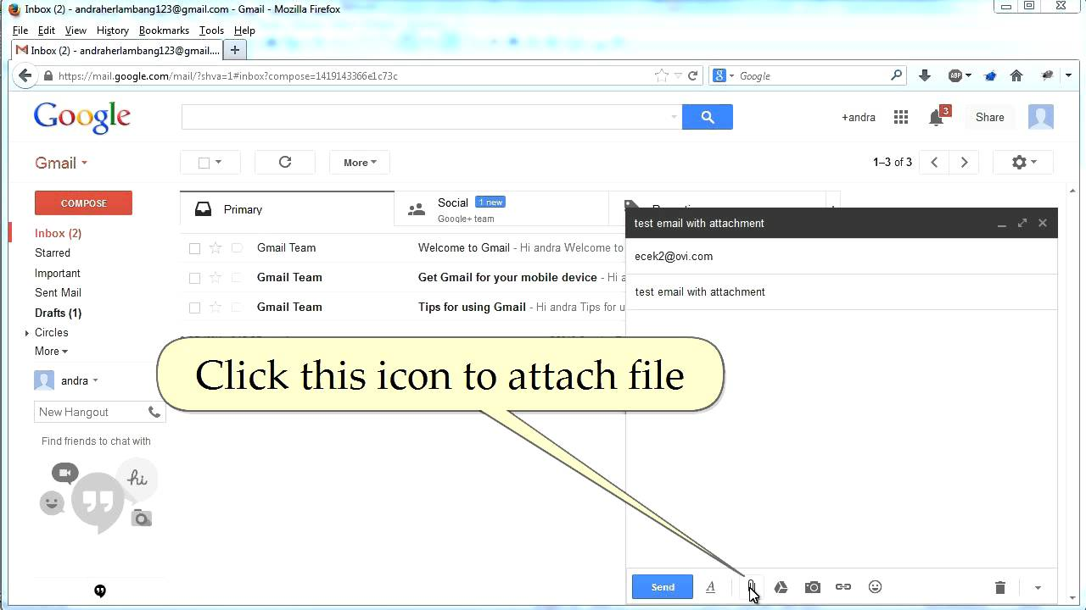
Email Writing
Attachments

Slide 11
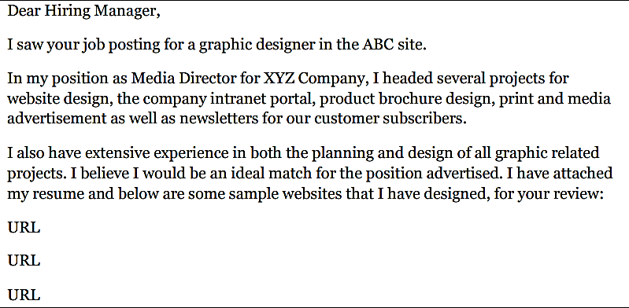
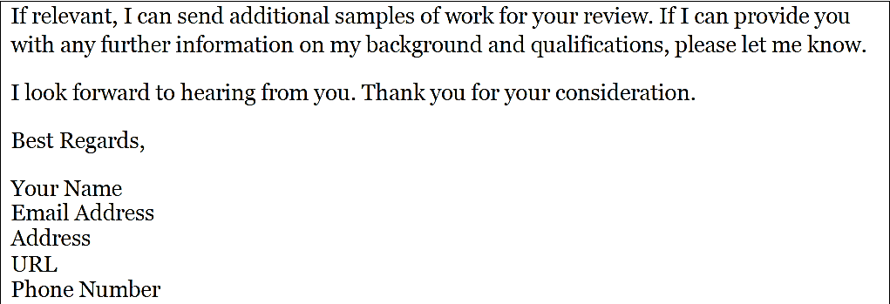

Job Cover Letter Email*
*Source: http://www.qgroupplc.com/?catid={C07567E5-9742-4A9F-8940-261D1E629EC5}#{4FB078D9-DD5A-4058-9FB1-B635C84261FB

Slide 12
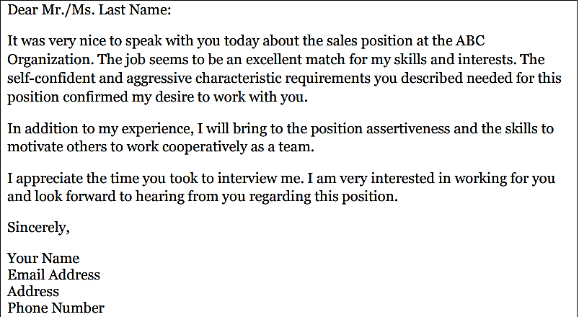
Job Interview Thank you Email*
*Source: http://www.qgroupplc.com/?catid={C07567E5-9742-4A9F-8940-261D1E629EC5}#{4FB078D9-DD5A-4058-9FB1-B635C84261FB

Slide 13
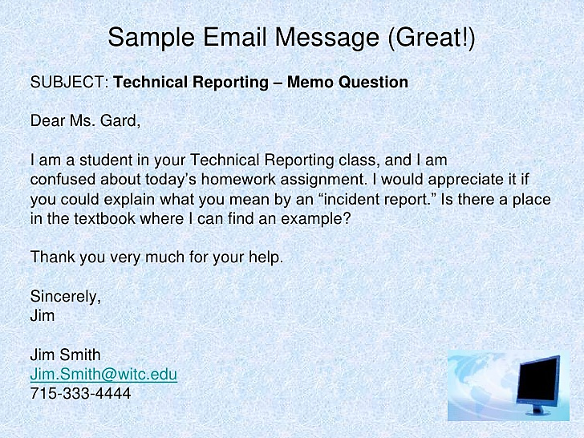

Slide 14
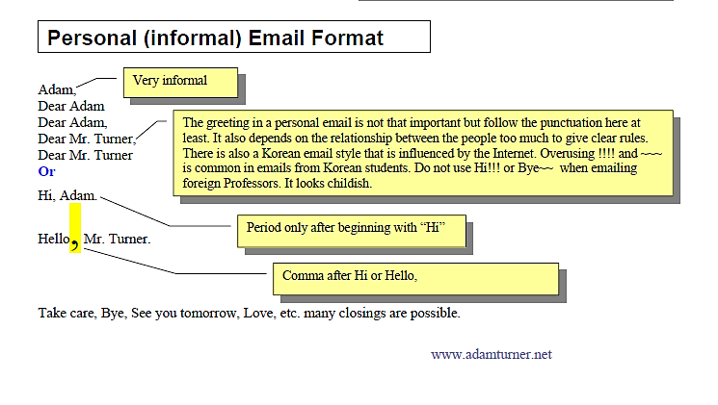

Slide 15
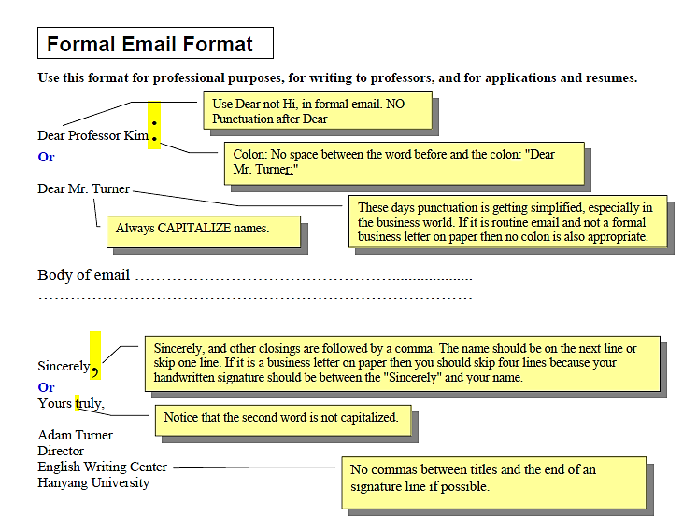

Slide 16

Email Writing
Spamming and Flaming
Spamming and flaming are two types of email abuse. It is important to understand what constitutes email abuse so you do not contribute to it yourself. It is also good to know how to respond to email abuse when it happens to you.
If you are new to the Internet, you won't see a lot of spam right away. After you have been online awhile, you will begin to see spam from time to time. How much you get depends on how visible your own email address is, who has collected it, who has sold it and who has bought it.

Slide 17
Email Writing
What do you do if you find you are getting spam? There are several things you can do:
Use the delete key! This is the easiest and quickest way. It works best if you are getting only the occasional spam message
You can use filter and folders or even shareware packages to help you direct your spam into one folder
To prevent spam, learn more about the various ways that spammers obtain email addresses. Never post your email address on a public web page. Make sure you read all privacy agreements when you purchase something on the web.

Slide 18
Email Writing
About Flame
A flame is an email or newsgroup message in which the writer attacks another person with uninhibited hostility. A flame war is an exchange of flames between two or more participants. Flames can be contagious.
Emotions have a way of generating more emotions, so it is a good idea to wait for a while before responding to an email that looks like a flame. You may have misinterpreted the original email message. The best way to stop a flame war is to not respond. If you are angry or upset about something, deal with it face-to-face.

Slide 19

Email Etiquettes-Conventions
Do [1/3]
Use the subject line to capture your reader's attention.
Put the key point of your message up front. Restrict the message to one topic whenever possible.
Make it easy for the reader to reply yes or no or give a short answer
Make use of white space and legible font.
Personalize by using conversational tone (contractions, pronouns).
Respect common grammar & spelling conventions.

Slide 20
Email Etiquettes-Conventions
Do [2/3]
Proofread your message before sending it.
Make yourself look good online because your email can be forwarded to anyone or everyone else in the company or anywhere.
Send messages only to people who need to read them. Respect other people's time and don't forward junk email to them. Use CC: and BCC: sparingly.

Slide 21
Email Etiquettes-Conventions
Do [3/3]
Keep your message short and clear. Remember that the screen shows only about half of what you see on hard copy.
If your message is long, give a summary at the start.
Scan your resume for viruses before you attach it to your e-mail.
Think about the message your e-mail address sends. Keep your address simple, and avoid unprofessional names like “party girl”.
Treat your e-mail as if you were writing a professional cover or thank-you letter on paper.

Slide 22

Email Etiquettes-Conventions
Don’t [1/3]
Don't use email if the message needs to be private and secure (maybe the company has a policy on this).
Don't send an email you wouldn't want anyone else to read, it's too easy to forward.
Don't forward a message without a brief comment why you're forwarding it.
Don't leave subject line blank.
Don't type your message in capitals. Employers may think that you are screaming. It is also difficult to read. Capitals are considered to be SHOUTING and are rude.

Slide 23
Email Etiquettes-Conventions
Don’t [2/3]
Don't overrun emails with smiley faces or other emoticons.
Don't let emotions or offensive language detract you from your message.
Don't just rely on e-mail. E-mail can be lost. Follow-ups can often be done via the telephone or regular mail.
Don't type your entire message in lower case.

Slide 24
Email Etiquettes-Conventions
Don’t [3/3]
Don’t use internet acronyms (OMG, WTH, GTG, etc.)
Don’t’ use all lower case (i’ll meet you in an hour) or all capitals (I’LL MEET YOU IN AN HOUR)
Don’t’ use slang (OMG George is such an idiot!)
Don’t’ use idioms (rock the boat, or that cost an arm and a leg)
Don’t’ write statements that speak for the entire organization, unless permission from your supervisor has been given

Slide 25
Email Writing
Vocabulary
More Polite
Thank you
I would like to apologize for…
I would appreciate it if you…
Would you happen to know…?
Unfortunately, I will not be able to…
Less Polite
Thanks
Sorry for…
Can you…?
Do you know…?
I can’t…

Slide 26
Email Writing
Useful Expressions
Permissions
May I come in? (More Formal)
Can I come in? (Less Formal)
Requests
Would you mind if I leave early? (More Formal)
I’m leaving early, you don't mind, do you? (Less Formal)
Suggesting and Inviting
Would you like to go outside? (More Formal)
Why don't we go outside? (Less Formal)

Slide 27
Conclusions
Email Structure
Dos and Don’ts
Vocabulary and Useful Expressions

